Slide 1



Frequent detection of TFV-DP among young Kenyan women in a PrEP implementation program
Jillian Pintye, John Kinuthia, Felix Abuna, Kenneth Mugwanya, Harison Lagat, Julia Dettinger, Daniel Odinga, Joseph Sila, Jared M. Baeten, Grace John-Stewart
PrEP Implementation for Young Women and Adolescents (PrIYA) Program
Notes:
Thank you all for coming today and for listening to our talks in this session. First, I’d like to take a moment to acknowledge the collaborative team that I represent from the University of Washington in Seattle and Kenyatta National Hospital in Nairobi.

Slide 2
High HIV incidence during pregnancy
Pooled incidence estimate = 4.7 HIV infections per 100 person-years during pregnancy
Drake et al PLOS MED 2014
Notes:
HIV incidence is alarmingly high among young women in East and Southern African settings and persists during periods of pregnancy. (CLICK) A systematic review conducted by Dr. Alison Drake from our UW team found that pregnant African women have HIV incidence rates similar to groups commonly thought of as being at particularly high-risk for HIV such female sex workers.

Slide 3

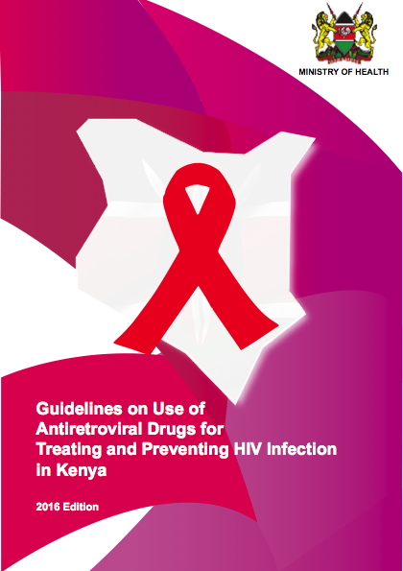
Notes:
In 2017, the World Health Organization released recommendations that include HIV-negative pregnant women, in settings where HIV prevalence is high, among the groups who should be offered PrEP. Several HIV high-burden countries are considering or are launching programmatic PrEP delivery for pregnant and postpartum mothers, including where much of my team’s work is conducted in Kenya, which includes pregnant and breastfeeding women in its national PrEP guidelines.

Slide 4

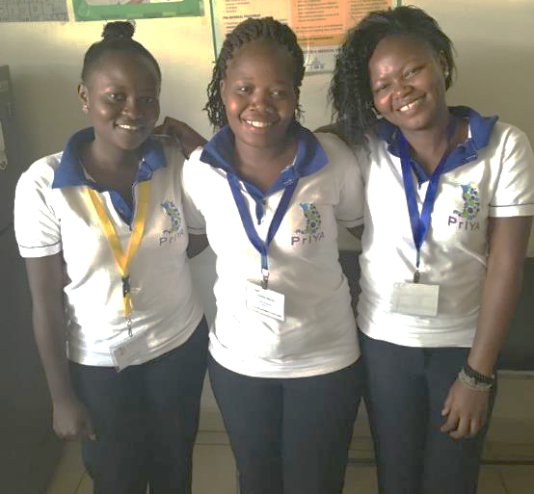
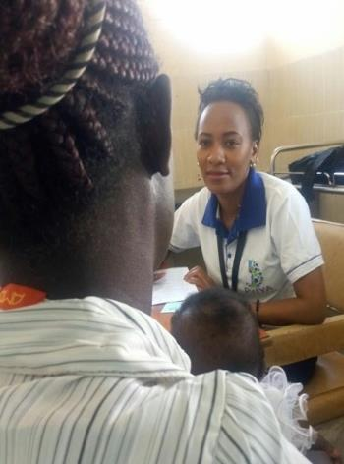


Integrated delivery approach
Notes:
Our team recently completed the world’s first large-scale PrEP program for pregnant and postpartum women. The PrEP Implementation for Young Women and Adolescents or “PrIYA” Program aimed to provide real-world evidence on delivering PrEP integrated within 16 routine maternal child health and family planning clinics in Kisumu, Kenya. This means that women were counselled on PrEP and, if they wanted to initiate, they received PrEP pills directly from the clinic where they receive their MCH and FP care, often from the same nurse. Here are PrIYA nurses Christine, Joyness and Veronica on the left and Rose on the right. They are all nurses who provide routine services while also counselling and initiating women on PrEP.

Slide 5
In a review of more than 150 thousand pregnancies, Andrade et al found that while the majority (78%) of pregnant women are exposed to either class B or C drug
Key lessons
Reasons for not enrolling into mHealth system
Women initiate PrEP when offered in MCH/FP…
~40% continued PrEP
at 1-month
n=21,291
n=4,684
Mugwanaya et al CROI 2019; Kinuthia et al IAS 2018; Mugwanya et al IAS 2018
Notes:
Through PrIYA, over 21,000 unique women were screened for PrEP and over 4600 initiated. PrEP uptake was about 20% in PrIYA overall and up to 80% among women with known risk factors like having a partner who is known to be HIV-positive. (CLICK) Similar to other PrEP programs, early discontinuation was frequent, yet at 1-month post-initiation almost 40% of continued PrEP, meaning they returned for follow-up visits and refilled their prescription. We sought to understand adherence among that group of women who continued PrEP within a subset of PrIYA which is what I’ll present today.

Slide 6
Objective
Evaluate tenofovir-diphosphate (TFV-DP) detection in dried blood spots (DBS) collected from young women in Kenya who initiated PrEP within routine maternal child health (MCH) and family planning (FP) clinics
Notes:
The objective of the current analysis was to evaluate detection of tenofovir-diphosphate, an objective biomarker of PrEP adherence, among women who initiated PrEP within routine MCH and FP clinics in a subset of the PrIYA Program.

Slide 7
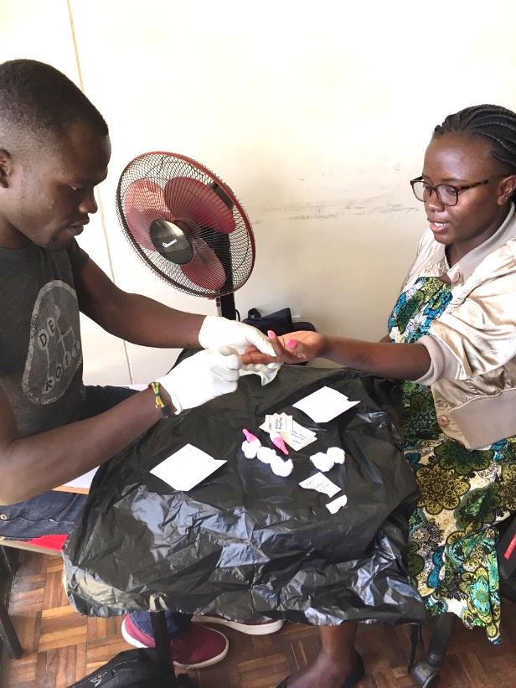
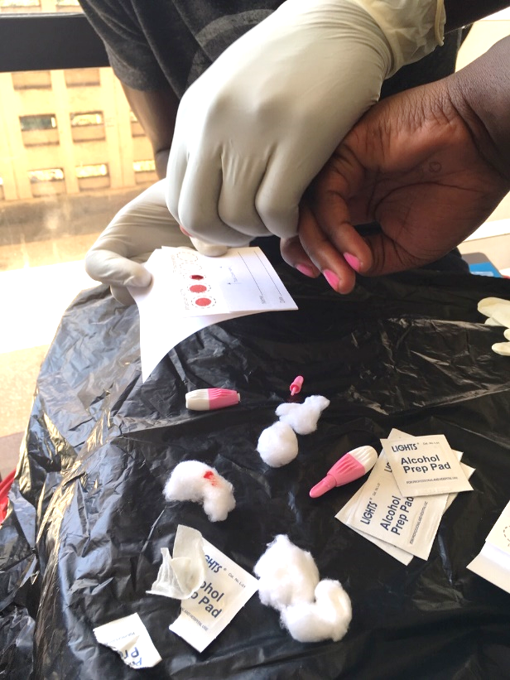
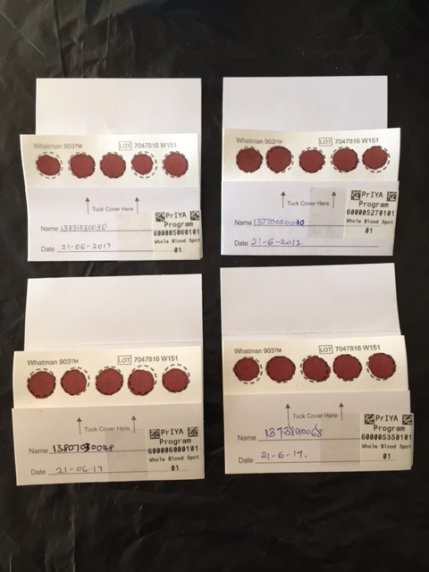
Methods
  Trained program nurses trained on DBS collection
  Conducted continuous QA/QC
  Demonstrated competency
Notes:
We trained all PrIYA program nurses on DBS collection. These are nurses Tony and Celestine practicing on each other in our Kisumu office. (CLICK) Prior to starting DBS collection in the field, each nurse had to demonstrate mastery of skills by collecting a minimum of 5 acceptable DBS. (CLICK) And once DBS collection commenced at dispersed sites, we conducted continuous QA/QC procedures to ensure high quality DBS were collected and made it to the freezer within viable window.

Slide 8


Methods
DBS collected at all in-person PrEP follow-up visits
Randomly selected 20% of DBS for TFV-DP testing
  Took PrEP in the last 14 days
  Testing at Anderson Lab (UC Denver)
Jun
Apr
Jul
Dec
2017
2018
PrIYA begin; DBS at 4 sites
DBS at
16 sites
DBS selected
for testing
PrIYA ends
Notes:
DBS were collected at all routinely scheduled PrEP follow-up visits that were attended in-person. DBS collection started at 4 sites and then gradually scaled up to all 16 program-dedicated sites as depicted here on this timeline. In July 2018, we randomly selected DBS from 20% of in-person PrEP follow-up visits where the clients reported having used PrEP in the last 14 days. And testing was conducted on the randomly selected DBS using validated assays by the Anderson Lab at the University of Colorado in Denver.

Slide 9
No. of in-person follow-up visits among PrEP initiators
(n=5025)
Excluded (n=3893)
No DBS collected (n=2117)
No PrEP use in last 14 days (n=874)
No data on PrEP use (n=873)
DBS data missing (n=29)
No. of follow-up visits with DBS available for testing
(n=1132)
Not randomly selected for testing (n=899)
Rejected by lab (n=1)
No. of follow-up visits with DBS results available*
(n=233)
*1 additional DBS tested from seroconverter
Notes:
Overall, PrIYA participants who initiated PrEP attended 5,025 in-person follow-up visits. (CLICK) Among those follow-up visits, 1,132 met inclusion criteria for DBS testing. DBS were not collected at 42% of follow-up visits since DBS collection procedures were initiated at sites at different times as I mentioned previously. We excluded DBS from women who either did not have information available on recent PrEP use or those who reported not taking PrEP in the last 14 days. (CLICK) And among follow-up visits that met inclusion criteria, we randomly selected 233 DBS for testing. This translates to 5% of overall follow-up visits and 20% that met inclusion criteria. One randomly selected sample was rejected by the lab prior to testing and we also tested an additional sample from a participant who seroconverted after initiating PrEP; this was the only PrEP-initiating client to seroconvert during the PrIYA Program.

Slide 10
Reasons for not enrolling into mHealth system
Characteristics of PrEP initiators who returned for in-person follow-up visit (n=2155)
Reasons for not enrolling into mHealth system
 | PrEP initiators with DBS results (n=201) | PrEP initiators without DBS results (n=1954)
Age (median) | 25 years | 24 years
Recruitment clinic MCH | 88% | 92%
FP | 12% | 8%
Married | 84% | 82%
Partner HIV-positive** | 25% | 10%
Had sex without a condom¹ | 99% | 99%
Forced to have sex against will¹ ** | 5% | 2%
Experienced IPV¹ | 8% | 5%
*p<0.05; ¹ In the last 6 months
Notes:
Among the 233 DBS tested, 201 were from unique women. Median age of unique PrEP initiators with DBS results was 25 years, 88% were from MCH clinics and most were married. Condomless sex was very frequently reported, other risk factors less so. (CLICK) We compared characteristics of PrEP initiators with DBS results with those whose samples were not selected for testing, to understand how representative our results were of the overall population of women who initiated PrEP and returned for in-person follow-up visits. We did not find significant differences across groups, with the exception that women with DBS tested more frequently had partners who were known to be HIV-positive and more frequently were forced to have sex in the last 6 months.

Slide 11
Reasons for not enrolling into mHealth system
Median time since PrEP initiation
Frequency of detectable TFV-DP
Reasons for not enrolling into mHealth system
201 DBS from 1st follow-up visits
5 weeks
(IQR 4-18)
62%
Reasons for not enrolling into mHealth system
31 DBS from later follow-up visits
24 weeks
(IQR 17-37)
90%
Reasons for not enrolling into mHealth system
1 DBS from seroconverter
None detected
5 weeks
Notes:
Among the 201 DBS from unique women attending 1st follow-up visits, the median time since PrEP initiation was 5 weeks. (CLICK) 31 DBS were from subsequent follow-up visits among the same women at a median of 24 weeks since PrEP initiation. (CLICL) And the one seroconverter DBS was also from 5 weeks since PrEP initiation.

Slide 12
Reasons for not enrolling into mHealth system
Median time since PrEP initiation
Frequency of detectable TFV-DP
201 DBS from 1st follow-up visits
5 weeks
(IQR 4-18)
62%
31 DBS from later follow-up visits
24 weeks
(IQR 17-37)
90%
1 DBS from seroconverter
None detected
5 weeks
Notes:
Overall, 66% of the randomly selected DBS had any detectable TFV-DP. The frequency was 62% among 1st follow-up visits and 90% among later follow-up visits. There was no detectable TFV-DP in the seroconverter DBS, indicating non-adherence.

Slide 13
Reasons for not enrolling into mHealth system
Frequency of detectable TFV-DP
Risk Ratio* | p-value
1.4 (1.1-1.8) | 0.002
1.3 (1.0-1.8) | 0.048
2.4 (1.7-3.4) | <0.001
1.6 (1.1-2.3) | 0.016
ref
Age
Pregnancy status
Reasons for not enrolling into mHealth system
Partner HIV status
Reasons for not enrolling into mHealth system
*Poisson regression models accounts for participant-level clustering
*Poisson regression models accounts for participant-level clustering
Notes:
Women older than 24 years more frequently had detectable TFV-DP than younger women. (CLICK) Compared to pregnant women, non-pregnant women more frequently had detectable levels. (CLICK) Almost all of women who reported having a partner known to be HIV-positive had detectable levels, the frequency was over twice as high as women who reported having HIV-negative partners. Women who had partners with unknown HIV status also more frequently had detectable drug levels compared to women with HIV-negative partners. We repeated our Poisson models restricting to only 1st PrEP follow-up visits and the results were very similar.

Slide 14
Limitations
Relied on routinely collected data for PrEP outcomes
Only used DBS as biomarker for PrEP adherence
Most samples from early PrEP follow-up visits
Notes:
We intentionally built a programmatic evaluation in a routine delivery setting to investigate what adherence would be within this real-world context. However, we relied heavily on routinely collected data which had a lot of missingness and may be less reliable than more rigorous study data. We also only used DBS as a biomarker for objective PrEP exposure which measures TFV-DP levels in red blood cells. Future evaluations could incorporate other biomarkers of PrEP exposure. Additional studies are needed to address longitudinal patterns of adherence as we mostly included results from early follow-up visits without multiple time points.

Slide 15
Conclusions and Implications
Frequent detection of TFV-DP (66% overall)
  Higher among older, non-pregnant women
  Highest among women with HIV-positive partners
Achievement of reasonable PrEP adherence possible
Adherence strategies increasingly important in MCH/FP
Notes:
In this programmatic evaluation of PrEP delivery to Kenyan women, two-thirds of blood samples had detectable drug levels. Women who had known HIV-positive partners, were not pregnant, and were ≥24 years were more likely to have TFV-DP detected, but the majority of women with partners of unknown status and those <24 years also had detectable levels. There may be biological or behavioral reasons for differences in PrEP exposure during pregnancy, additional studies are needed to investigate that. In summary, our data suggest that PrEP programs for African women can achieve reasonable PrEP adherence, yet as PrEP implementation advances more strategies for enhancing adherence in real-world MCH and FP settings will become increasing important.

Slide 16
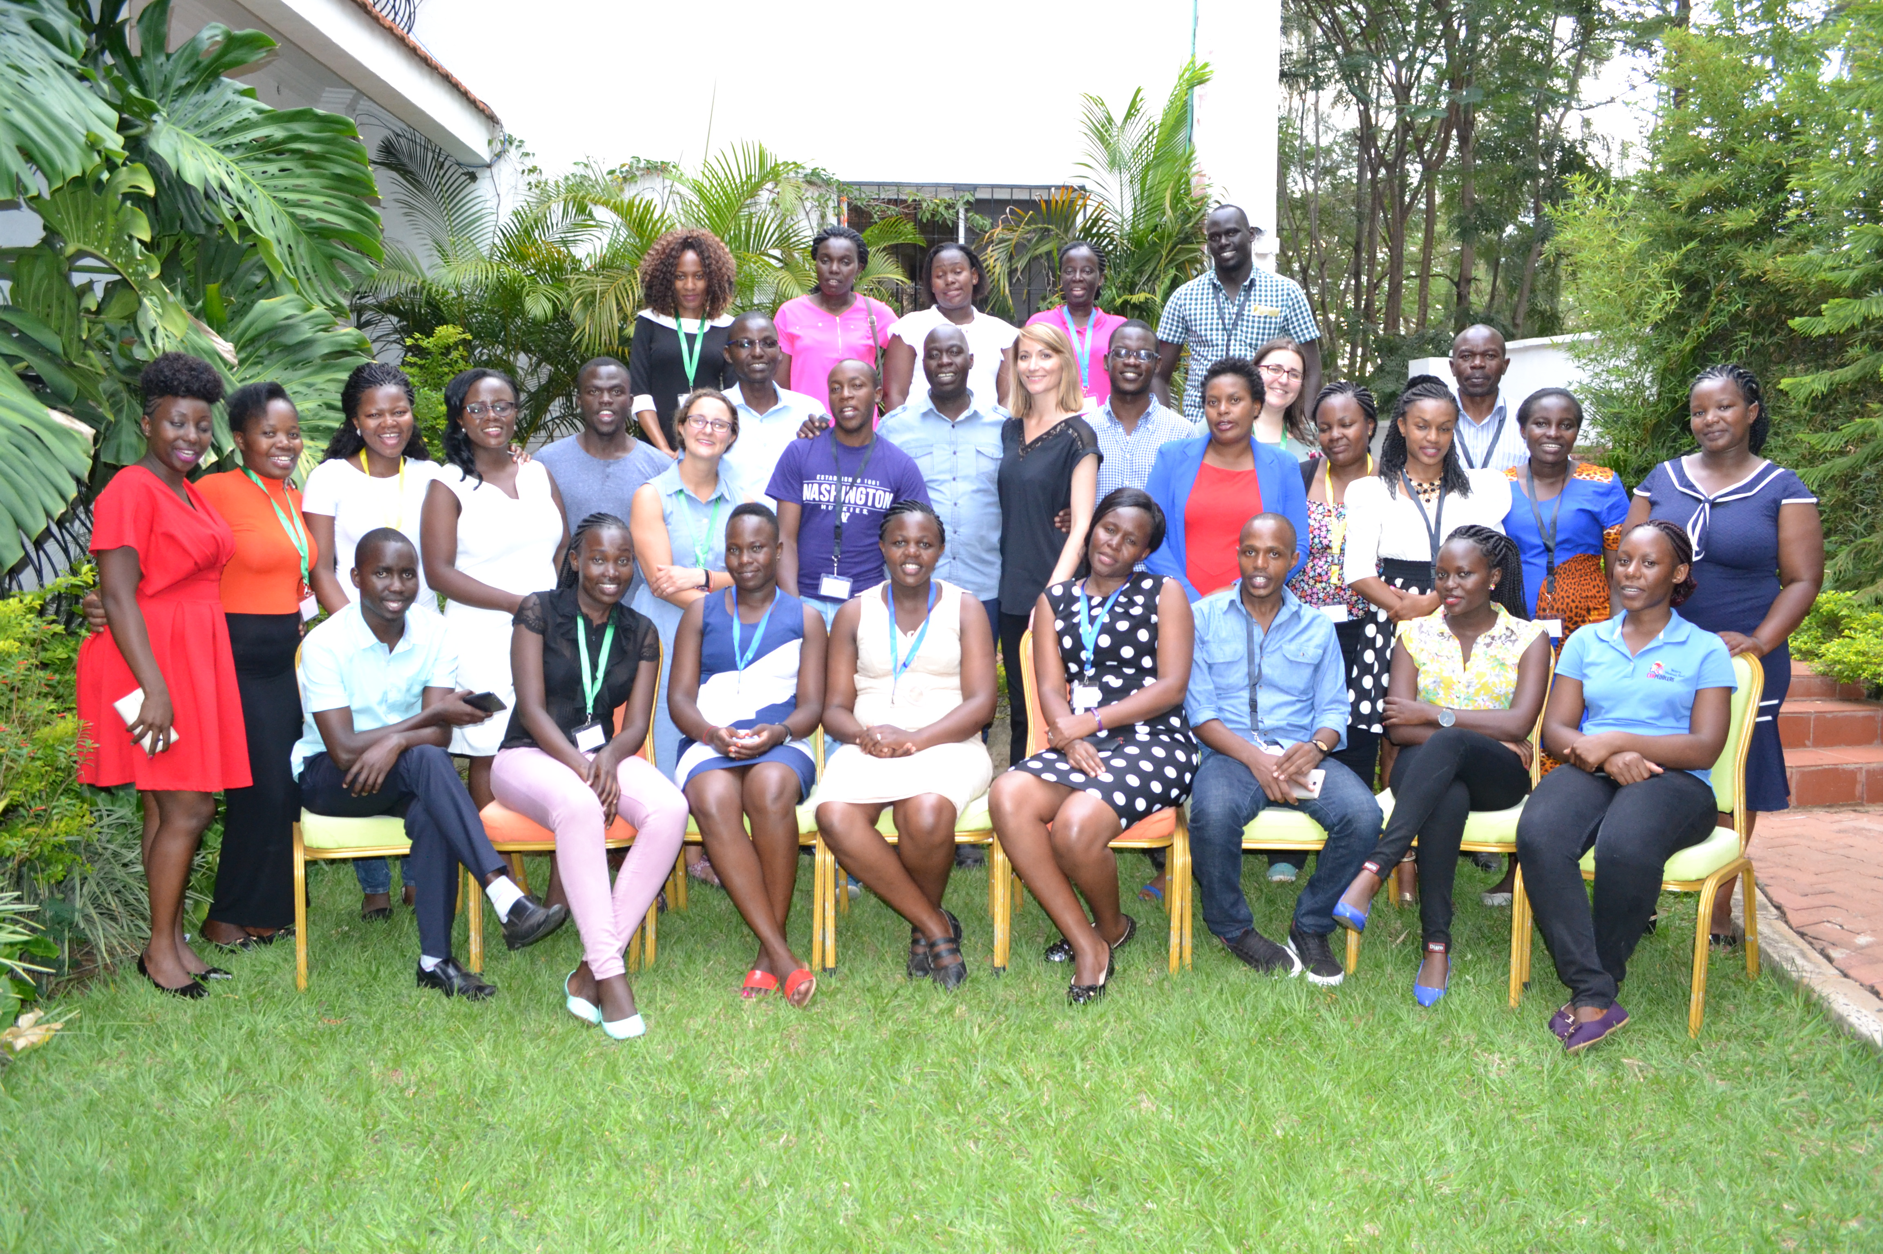
Notes:
I’d like to take a special moment to thank the nurses who worked on the program and collected all of the DBS from participants as well as our lab managers and coordinators in Kisumu who make everything happen. And as a nurse myself, I’ve been incredibly inspired by the dynamic team of nurses that I have the privilege of working with who are in this photo here.

Slide 17





Acknowledgments
We gratefully acknowledge all of the PrIYA participants.
PrIYA and PrIMA project staff, the Kenyan Ministry of Health, and the Kisumu County Government.
This study was funded by the National Institutes of Health (R01HD094630).
PrIYA was funded by the United States Department of State as part of the DREAMS Innovation Challenge, managed by JSI Research & Training Institute, Inc.
Special thanks to Julia Dettinger for photos.
Notes:
We also gratefully acknowledge all of PrIYA participants, and our generous funders at the NIH and the US Dept of State. Thank you.

Slide 18
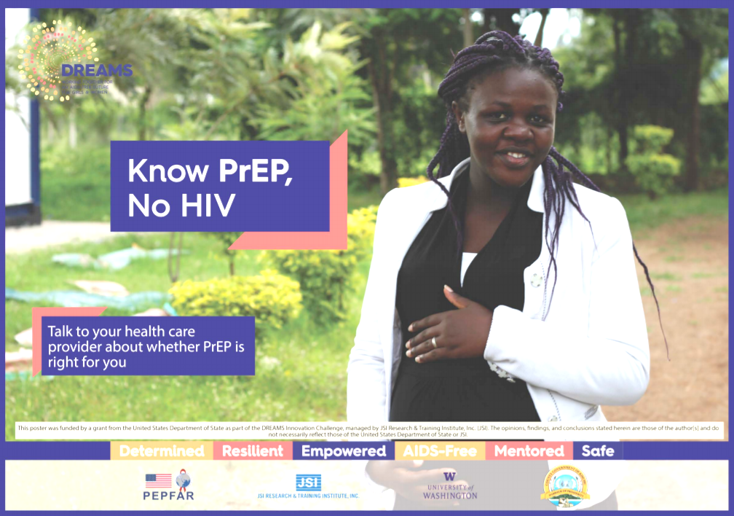
http://sites.google.com/uw.edu/priya
When I was pregnant taking iFAS would help me to remember, I was taking it at night so I
would take them all at once but now I’m used to taking it before I go to sleep
Notes:
One final plug, if you’d like to learn more about PrIYA or access our training package for implementing PrEP in MCH please visit our website at this link. Here is one of posters and this is PrIYA Nurse Larvine volunteer modeling. Thank you.

